Slide 1
Functional Dependencies and Normalization for Relational Databases
Source:Dr. Ali Obaidi
CS-450 Fall 2002
Modified By: Neha More

Slide 2
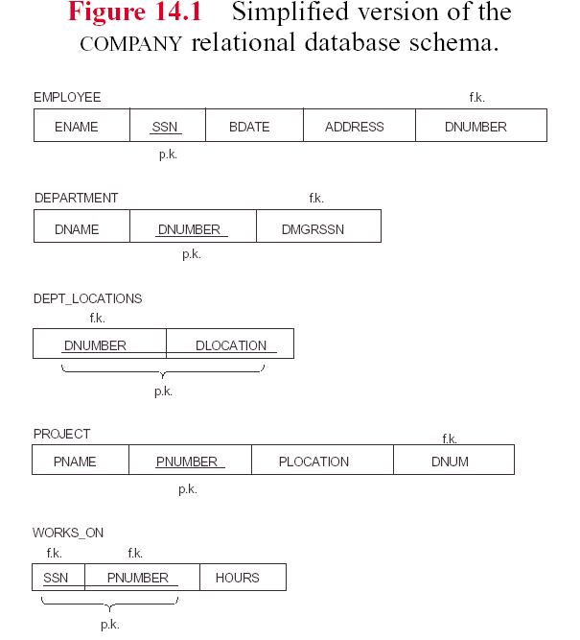

Slide 3
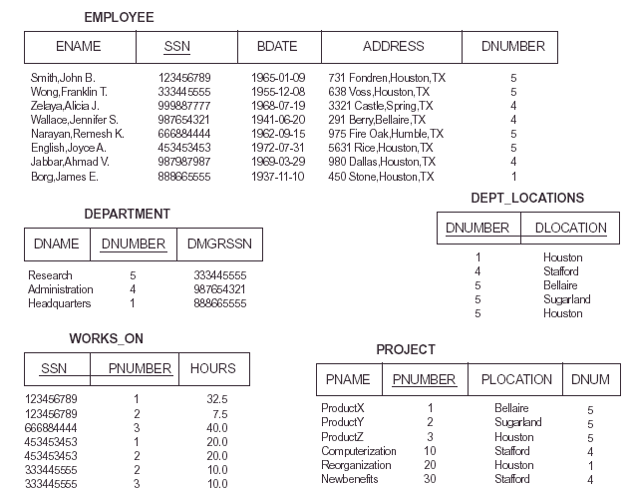

Slide 4
Redundant Information in Tuples and Update Anomalies
Mixing attributes of multiple entities may cause problems
Information is stored redundantly wasting storage
Problems with update anomalies:
Insertion anomalies
Deletion anomalies
Modification anomalies

Slide 5
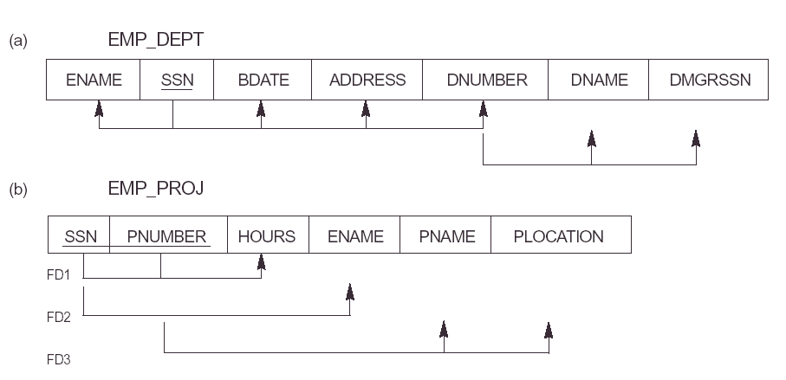
Mixing Attributes of Multiple Entities

Slide 6
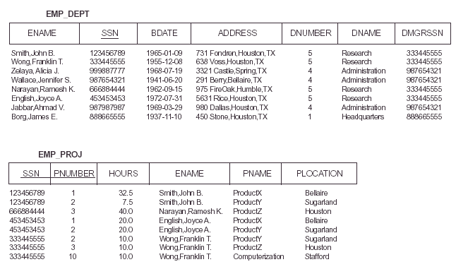

Slide 7
Anamoly
Anomalies are the problem that can occur in poorly planned, Un-normalized database where all the data is stored in one table .
Three types:
1)Insertion
2)Deletion
3)Updation

Slide 8
EXAMPLE OF AN UPDATE ANOMALY
Update Anomaly:
An Update Anomaly exists when one or more instances of duplicated data is updated, but not all.
the relation:
Suppose the manager of the department has changed, this requires that DMGR in all touples corresponding to that department must be changed to reflect the new status. If we fail to update all the touples of the given department , then two different record of employee working in the same department might show different DMGR leading to inconsistency in the database.

Slide 9
An Update Anomaly exists when one or more instances of duplicated data is updated, but not all. For example, consider Jones moving address - you need to update all instances of Jones's address.
StudentNum | CourseNum | Student Name | Address | Course
S21 | 9201 | Jones | Edinburgh | Accounts
S21 | 9267 | Jones | Edinburgh | Accounts
S24 | 9267 | Smith | Glasgow | physics
S30 | 9201 | Richards | Manchester | Computing
S30 | 9322 | Richards | Manchester | Maths

Slide 10
EXAMPLE OF AN UPDATE ANOMALY (2)
Insert Anomaly : Inserting a record which does not exist at all.
Example:
Cannot insert a project unless an employee is assigned to .
Inversely- Cannot insert an employee unless he/she is assigned to a project.

Slide 11
An Insert Anomaly occurs when certain attributes cannot be inserted into the database without the presence of other attributes.
For example this is the converse of delete anomaly - we can't add a new course unless we have at least one student enrolled on the course.
StudentNum | CourseNum | Student Name | Address | Course
S21 | 9201 | Jones | Edinburgh | Accounts
S21 | 9267 | Jones | Edinburgh | Accounts
S24 | 9267 | Smith | Glasgow | physics
S30 | 9201 | Richards | Manchester | Computing
S30 | 9322 | Richards | Manchester | Maths

Slide 12
Example 2:
Consider a relation emp_dept with attributes:
E#
Ename
Adderss
D
Dname
Dmgr
Let us assume that new department has been started by the organization but initially there is no employee appointed for that department,then touple for this department cannot be inserted into the table as E# will havë “NULL”which is not allowed as E# is primary key.

Slide 13
EXAMPLE OF AN UPDATE ANOMALY (3)
Delete Anomaly : A Delete Anomaly exists when certain attributes are lost because of the deletion of other attributes.
Example: When a project is deleted, it will result in deleting all the employees who work on that project. Alternately, if an employee is the sole employee on a project, deleting that employee would result in deleting the corresponding project.

Slide 14
For example, consider what happens if Student S30 is the last student to leave the course - All information about the course is lost.
StudentNum | CourseNum | Student Name | Address | Course
S21 | 9201 | Jones | Edinburgh | Accounts
S21 | 9267 | Jones | Edinburgh | Accounts
S24 | 9267 | Smith | Glasgow | physics
S30 | 9201 | Richards | Manchester | Computing
S30 | 9322 | Richards | Manchester | Maths

Slide 15
Example: Delete Anomaly
Consider a relation emp_dept with attributes:
E#
Ename
Adderss
D#
Dname
Dmgr#
Now consider there is only one employee in some department and that employee leaves the organization then touple of that employee has to be deleted from the table, but in addition to that the information of the department also will get deleted.

Slide 16
Null Values in Tuples
Relations should be designed such that their tuples will have as few NULL values as possible
Attributes that are NULL frequently could be placed in separate relations (with the primary key)
Reasons for nulls:
a. attribute not applicable or invalid
b. attribute value unkown (may exist)
c. value known to exist, but unavailable

Slide 17
Functional Dependencies
Functional dependencies (FDs) are used to specify formal measures of the "goodness" of relational designs
FDs and keys are used to define normal forms for relations
FDs are constraints that are derived from the meaning and interrelationships of the data attributes

Slide 18
Functional Dependencies (2)
A Functional Dependency describes a relationship between attributes within a single relation.
An attribute is functionally dependent on another if we can use the value of one attribute to determine the value of another.
We use the arrow symbol → to indicate a functional dependency.
X → Y is read X functionally determines Y
Example: Employee_Name is functionally dependent on Social_Security_Number because Social_Security_Number can be used to uniquely determine the value of Employee_Name.

Slide 19
Functional Dependencies (3)
The attributes listed on the left hand side of the → are called determinants.
One can read A → B as, “A determines B”. Or more specifically: Given a value for A, we can uniquely determine one value for B.

Slide 20
Example:
Suppose we have a student table with attributes: Stu_Id, Stu_Name, Stu_Age. Here Stu_Id attribute uniquely identifies the Stu_Name attribute of student table because if we know the student id we can tell the student name associated with it. This is known as functional dependency and can be written as
Stu_Id->Stu_Name
OR
in words we can say Stu_Name is functionally dependent on Stu_Id.

Slide 21
Examples of FD constraints
Social Security Number determines employee name
SSN → ENAME
Project Number determines project name and location
PNUMBER → {PNAME, PLOCATION}

Slide 22
Inference Rules for FDs
Given a set of FDs F, we can infer additional FDs that hold whenever the FDs in F hold
Armstrong's inference rules
A1. (Reflexive) If Y subset-of X, then X → Y
A2. (Augmentation) If X → Y, then XZ → YZ
(Notation: XZ stands for X U Z)
A3. (Transitive) If X → Y and Y → Z, then X → Z
A1, A2, A3 form a sound and complete set of inference rules

Slide 23
Inference Rules for FDs
Consider a schema Employee_department
(SSN,Fname,lname,dno,dname)
Reflexive:X → Y
{fname, lname} → {fname}
Augmentation rule: if X → Y then XZ → YZ
If {SSN} → {fname} then: {SSN, DName}→{fname,DName}
Transitivity rule: if X → Y and Y → Z then X → Z
if{SSN} → {DNO}
{DNO} → {DName}
Then also: {SSN} → {DName}

Slide 24
Additional Useful Inference Rules
Decomposition
If X → YZ, then X → Y and X → Z
Union
If X → Y and X → Z, then X → YZ
Psuedotransitivity
If X → Y and WY → Z, then WX → Z

Slide 25
Introduction to Normalization
Normalization:
Process of examining anomalies and when detected, remove those anomalies by decomposing unsatisfactory "bad" relations by breaking up their attributes into smaller related relations
Database designers get their first look into how the data is going to interact in the database.
Finding problems with database structure at this stage is fairly easy to go back to E-R model and make changes
Trade-off between redundancy and performance. Reduces the redundancy but introduces the use of joins

Slide 26
Introduction to Normalization
Normal form: (A class of relations free from a certain set of modification anomalies) Condition using keys and FDs of a relation to certify whether a relation schema is in a particular normal form.
1NF
2NF
3 NF
Boyce-Codd normal form (BCNF)
Fourth normal form (4NF)
Fifth normal form (5NF)

Slide 27
Normalization Process
Specify the Key of the relation
Specify the functional dependencies of the relation
[Sample data (tuples) for the relation can assist with this step]
Apply the definition of each normal form (starting with 1NF)
If a relation fails to meet the definition of a normal form, change the relation (most often by splitting the relation into two new relations) until it meets the definition.
5. Re-test the modified/new relations to ensure they meet the definitions of each normal form.

Slide 28
UNF (Un Normalized Form)
Select the data source and convert into an un normalized table:
Create column headings
Identify a key for table
Enter sample data into table

Slide 29
First Normal Form
Disallows composite attributes, multivalued attributes, and nested relations(attributes whose values for an individual tuple are non-atomic)
Considered to be part of the definition of relation

Slide 30
Decomposing the relation into First Normal Form
Identify multivalued attributes / repeating attributes
Make a single tuple entry for each attribute value from multivalued attribute / Remove repeating attributes to a new table with the copy of the key from the UNF table
Create a composite key i.e. (key U multivalued attribute name ) / Assign a key to the new table which is the composite key i.e. key of UNF table U subset of repeating attribute(s)
Note: U means union

Slide 31
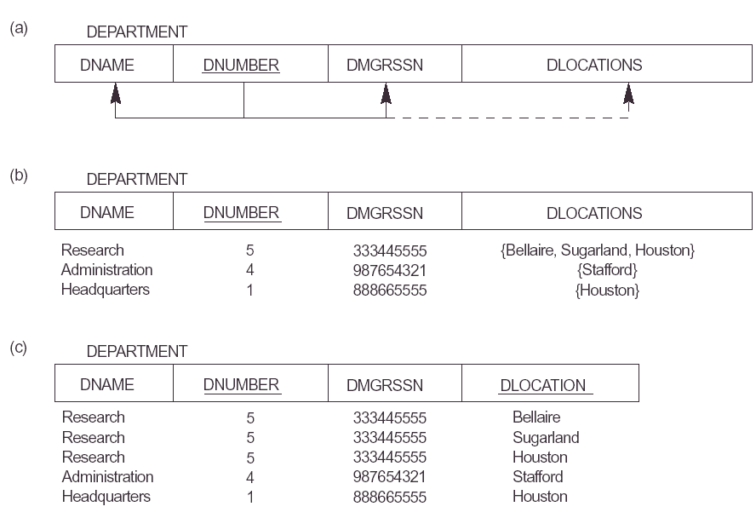

Slide 32
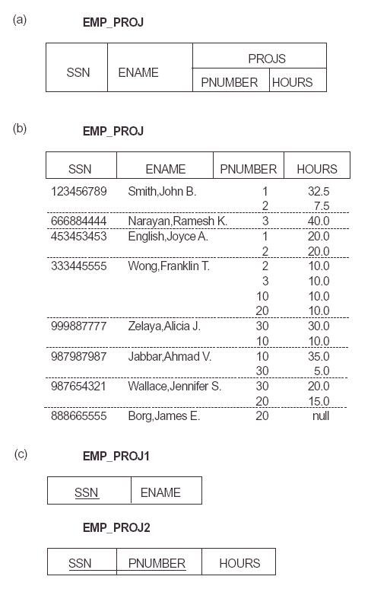

Slide 33
Second Normal Form
Uses the concepts of FDs, primary key
Definitions:
Prime attribute - attribute that is member of the primary key K
Full functional dependency - a FD Y → Z where removal of any attribute from Y means the FD does not hold any more

Slide 34
Second Normal Form(2)
A table should be in 1NF
There must not be any partial dependency of any column on primary key.
A table which has composite primary key, each column in the table that is not part of the primary key (non prime attribute) must depend upon the entire composite key for its existence.
If any column depends only on one part of the composite key, then the table fails Second Normal Form

Slide 35
Process From 1NF to 2NF
Take each non prime attribute in turn and ask the question
“Is this attribute dependent on one part of the key?”
If yes, remove attribute to new table with a copy of the part of the key it is dependent upon.
If no, check against other part of the key and repeat above process
if still no, i.e. not dependent on either part of key , keep attribute in current table.

Slide 36
Examples Second Normal Form
{SSN, PNUMBER} → HOURS is a full FD since neither SSN → HOURS nor PNUMBER → HOURS hold
{SSN, PNUMBER} → ENAME is not a full FD (it is called a partial dependency ) since SSN → ENAME also holds
Summary:
A relation schema R is in second normal form (2NF) if every non-prime attribute A in R is fully functionally dependent on the primary key

Slide 37
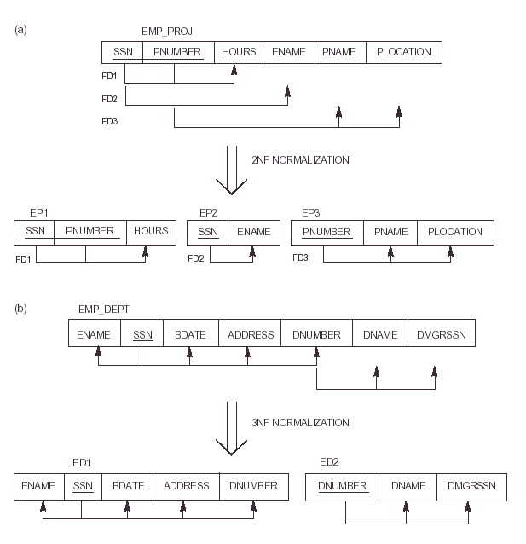

Slide 38
Third Normal Form
Definition
Transitive functional dependency – if there a set of attribute Z that are neither a primary nor candidate key and both X → Z and Y → Z holds.
Examples:
SSN → DMGRSSN is a transitive FD since
SSN → DNUMBER and DNUMBER → DMGRSSN hold
SSN → ENAME is non-transitive since there is no set of
attributes X where SSN → X and X → ENAME

Slide 39
Third Normal Form(2)
Let’s take an example to understand it better:
Book | Author | Author_age
Game of Thrones | George R. R. Martin | 66
Harry Potter | J. K. Rowling | 49
Dying of the Light | George R. R. Martin | 66
{Book} ->{Author} (if we know the book, we knows the author name)
{Author} does not ->{Book}
{Author} -> {Author_age}
Therefore as per the rule of transitive dependency: {Book} -> {Author_age} should hold

Slide 40
2NF to 3NF
A database is in third normal form if it satisfies the following conditions:
tables should be in 2NF
There is no transitive functional dependency:--
if a non-key attribute is more dependent on another non-key attribute than the table key then:
Move the dependent attribute, together with a copy of the non-key attribute upon which it is dependent, to a new table
Make the non-key attribute as key for the new table on which it is dependent
Leave the non-key attribute upon which it is dependent , in the original table and mark it as a foreign key.

Slide 42
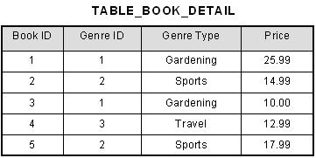
Consider the following example:
In the table able,
[Book ID] → [Genre ID],
[Genre ID] →[Genre Type].
Therefore, [Book ID] → [Genre Type] via [Genre ID] and we have transitive functional dependency, and this structure does not satisfy third normal form.

Slide 43
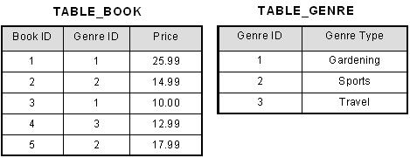
To bring this table to third normal form, we split the table into two as follows:

Slide 44
3rd Normal Form
A relation schema R is in third normal form (3NF) if it is in 2NF and there should not be any transitive dependency and functionally dependency among non prime attributes.

Slide 45
BCNF (Boyce-Codd Normal Form)
A relational schema R is considered to be in Boyce–Codd normal form (BCNF) if, for every one of its dependencies X → Y, one of the following conditions holds true:
X → Y is a trivial functional dependency (i.e., Y is a subset of X)
X is a superkey for schema R
Informally the Boyce-Codd normal form is expressed as “Each attribute must represent a fact about the key, the whole key, and nothing but the key.”

Slide 46
Example: Suppose there is a company wherein employees work in more than one department. They store the data like this:
emp_id | emp_nationality | emp_dept | dept_type | dept_no_of_emp
1001 | Austrian | Production and planning | D001 | 200
1001 | Austrian | stores | D001 | 250
1002 | American | design and technical support | D134 | 100
1002 | American | Purchasing department | D134 | 600

Slide 47
Functional dependencies in the table above:
emp_id -> emp_nationality emp_dept -> {dept_type, dept_no_of_emp}
Candidate key: {emp_id, emp_dept}
The table is not in BCNF as neither emp_id nor emp_dept alone are keys.

Slide 48
The table is not in BCNF as neither emp_id nor emp_dept alone are keys.
To make the table comply with BCNF we can break the table in three tables like this:
emp_nationality table:
emp_id | emp_nationality
1001 | Austrian
1002 | American

Slide 49
emp_dept table:
emp_dept | dept_type | dept_no_of_emp
Production and planning | D001 | 200
stores | D001 | 250
design and technical support | D134 | 100
Purchasing department | D134 | 600

Slide 50
emp_dept_mapping table:
emp_id | emp_dept
1001 | Production and planning
1001 | stores
1002 | design and technical support
1002 | Purchasing department
Candidate keys: For first table: emp_id For second table: emp_dept For third table: {emp_id, emp_dept}
This is now in BCNF as in both the functional dependencies left side part is a key.

Slide 51
3NF to BCNF Example
Let’s take a look at this table, with some typical data. The table is not in BCNF.
Author | Nationality | Book title | Genre | Number of pages
William Shakespeare | English | The Comedy of Errors | Comedy | 100
Markus Winand | Austrian | SQL Performance Explained | Textbook | 200
Jeffrey Ullman | American | A First Course in Database Systems | Textbook | 500
Jennifer Widom | American | A First Course in Database Systems | Textbook | 500

Slide 52
3NF to BCNF Example
The nontrivial functional dependencies in the table are:
author → nationality
book title → genre, number of pages
We can easily see that the only key is the set {author, book title}.
The same data can be stored in a BCNF schema. However, this time we would need three tables.

Slide 53
3NF to BCNF Example
Author | Nationality
William Shakespeare | English
Markus Winand | Austrian
Jeffrey Ullman | American
Jennifer Widom | American
Book title | Genre | Number of pages
The Comedy of Errors | Comedy | 100
SQL Performance Explained | Textbook | 200
A First Course in Database Systems | Textbook | 500

Slide 54
3NF to BCNF Example
Author | Book title
William Shakespeare | The Comedy of Errors
Markus Winand | SQL Performance Explained
Jeffrey Ullman | A First Course in Database Systems
Jennifer Widom | A First Course in Database Systems

